Slide 1
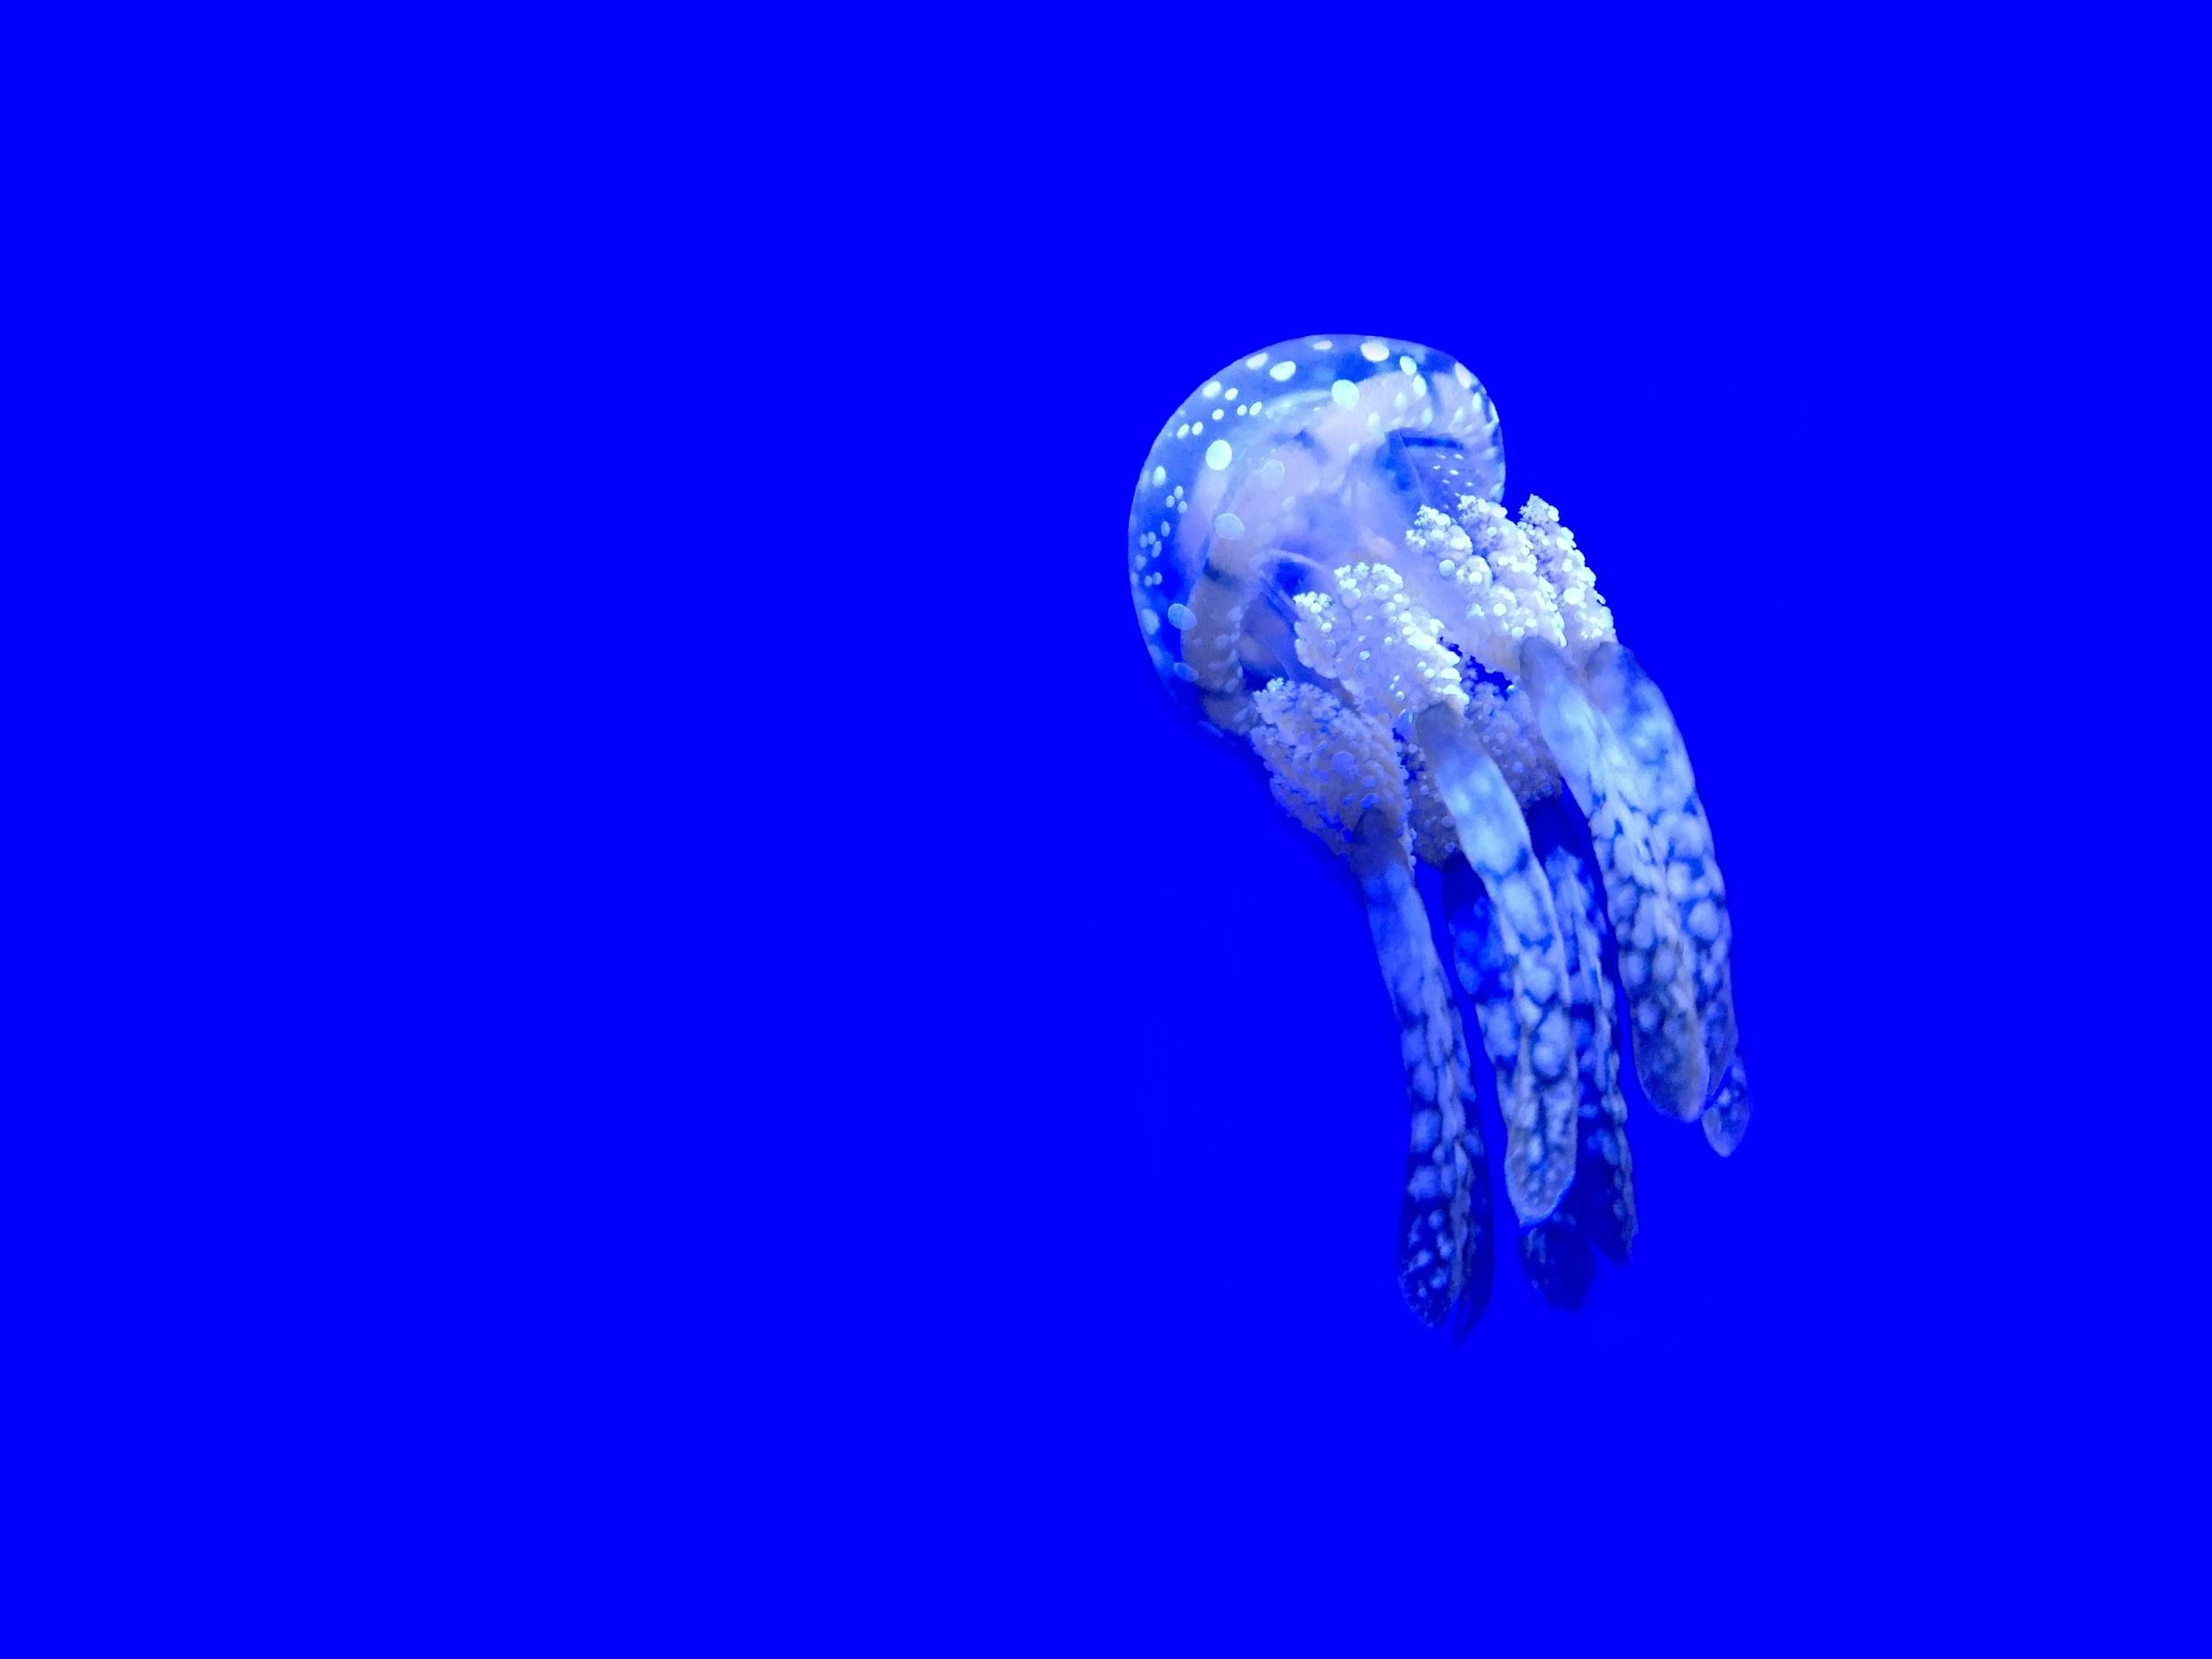
Kinyarwanda Voice-Interaction Hackathon: Deep Speech

Slide 2
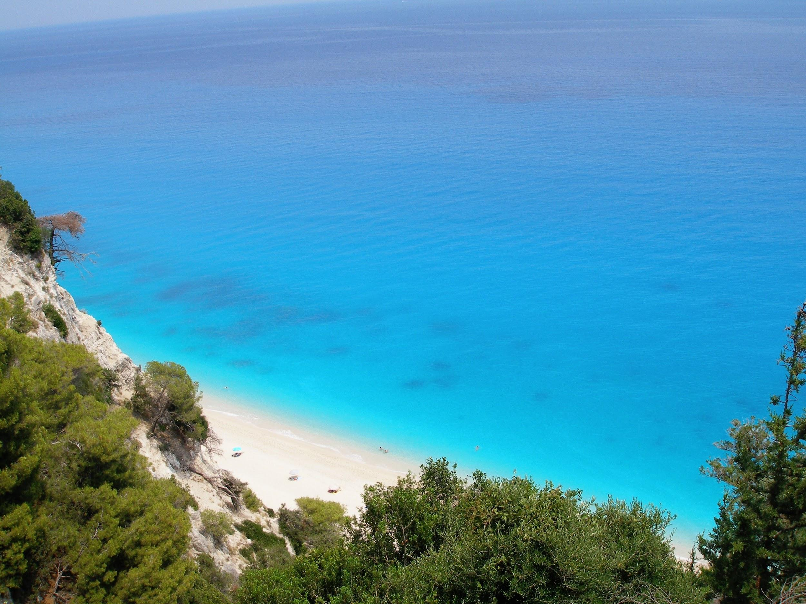
Outline
1 Intro
2 Deep Learning
3 Deep Speech
4 Future of Deep Speech

Slide 3
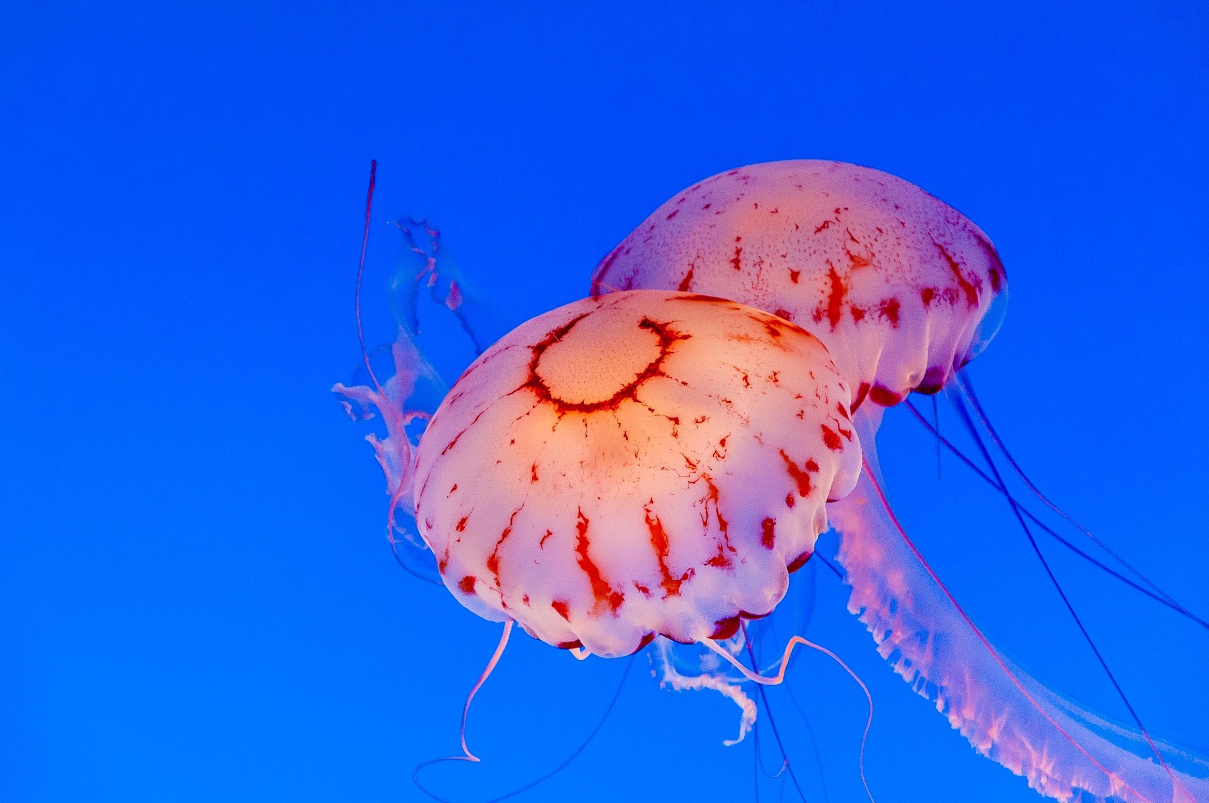
1 Intro

Slide 4

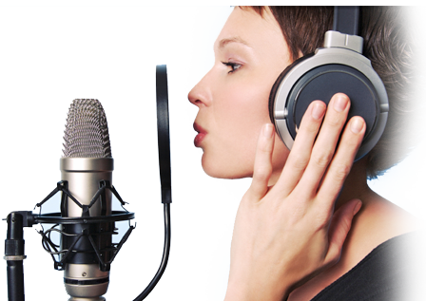
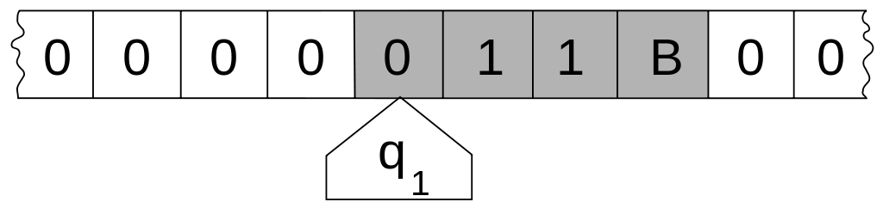
Intro: Speech-to-Text
"Mr. Watson, come here. I want to see you."
Speech
Computation
Text

Slide 5
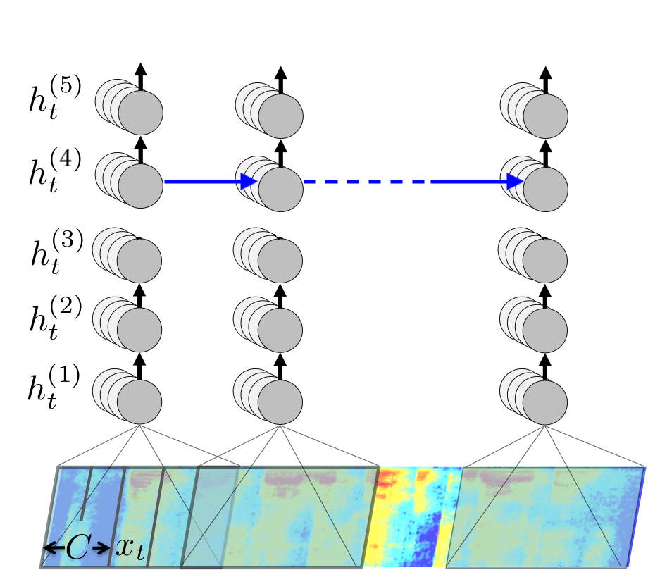
Intro: Deep Learning
Deep Learning

Slide 6

Intro: Speech-to-Text ∩ Deep Learning
Speech-to-Text
Deep Learning

Slide 7
2 Deep Learning

Slide 8

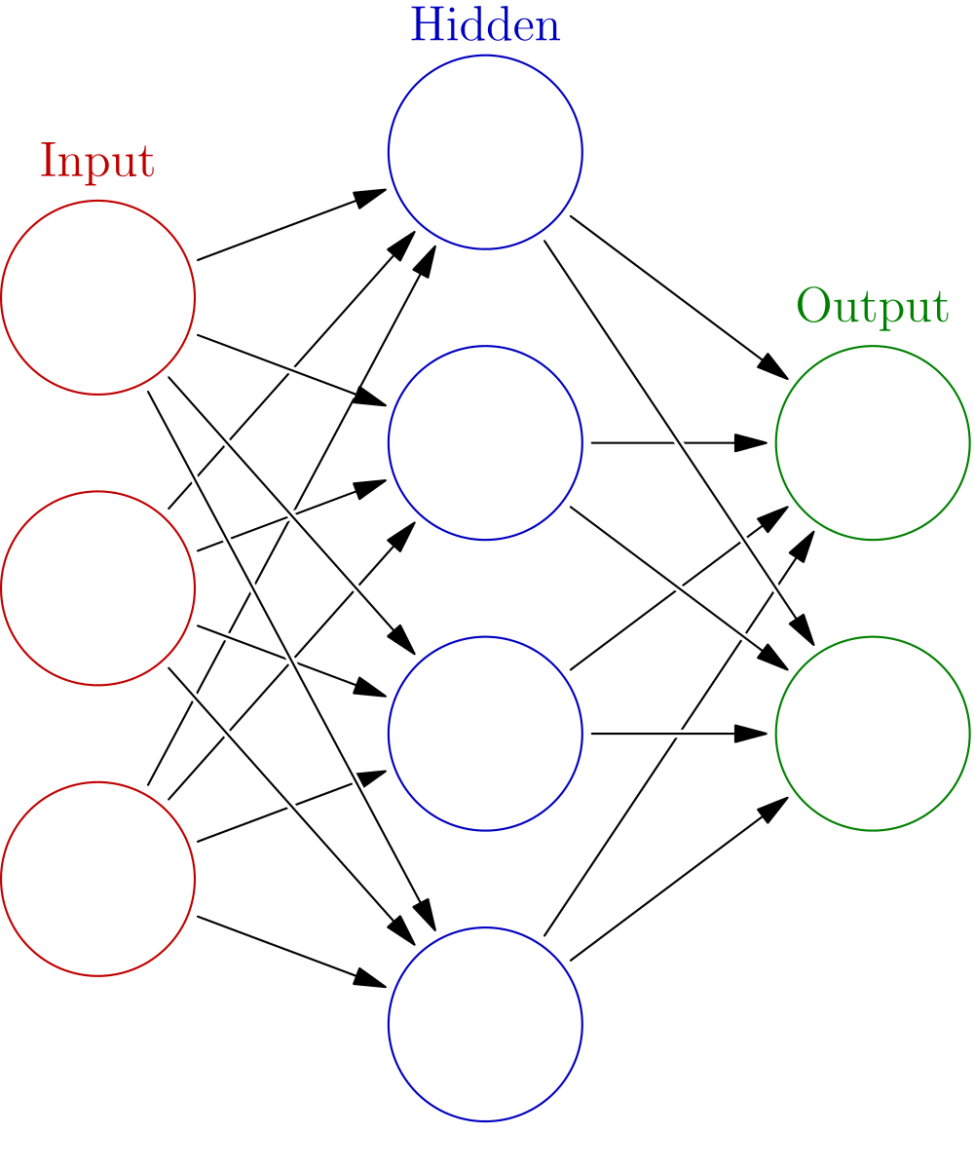
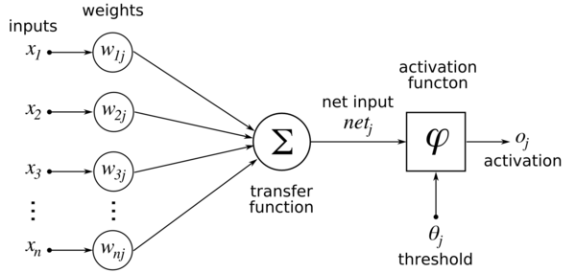
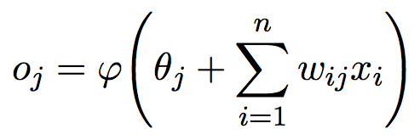
Deep Learning: Feed Forward Networks

Slide 9
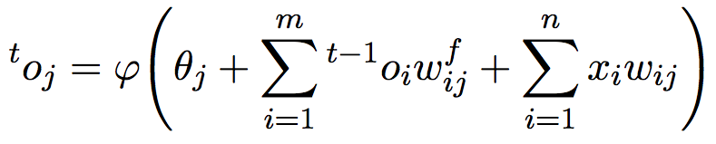
Deep Learning: Recurrent Neural Networks

Slide 10
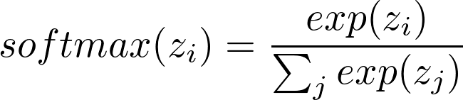
Deep Learning: Softmax

Slide 11
3 Deep Speech

Slide 12
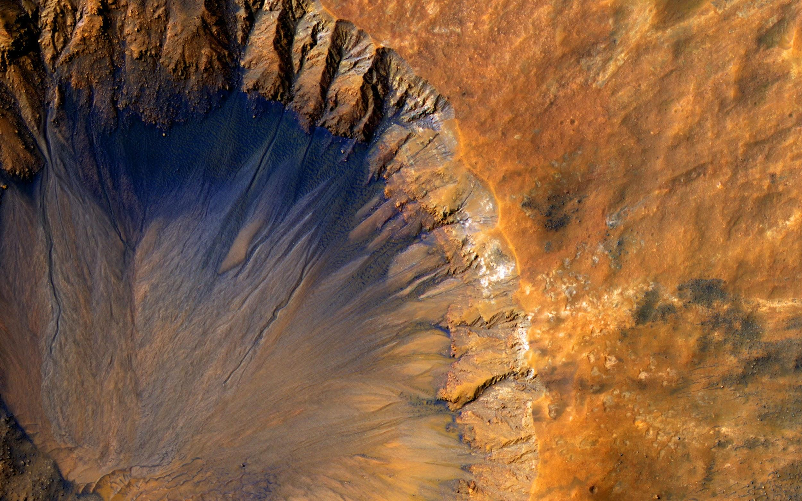
3.1 Deep Speech Architecture

Slide 13
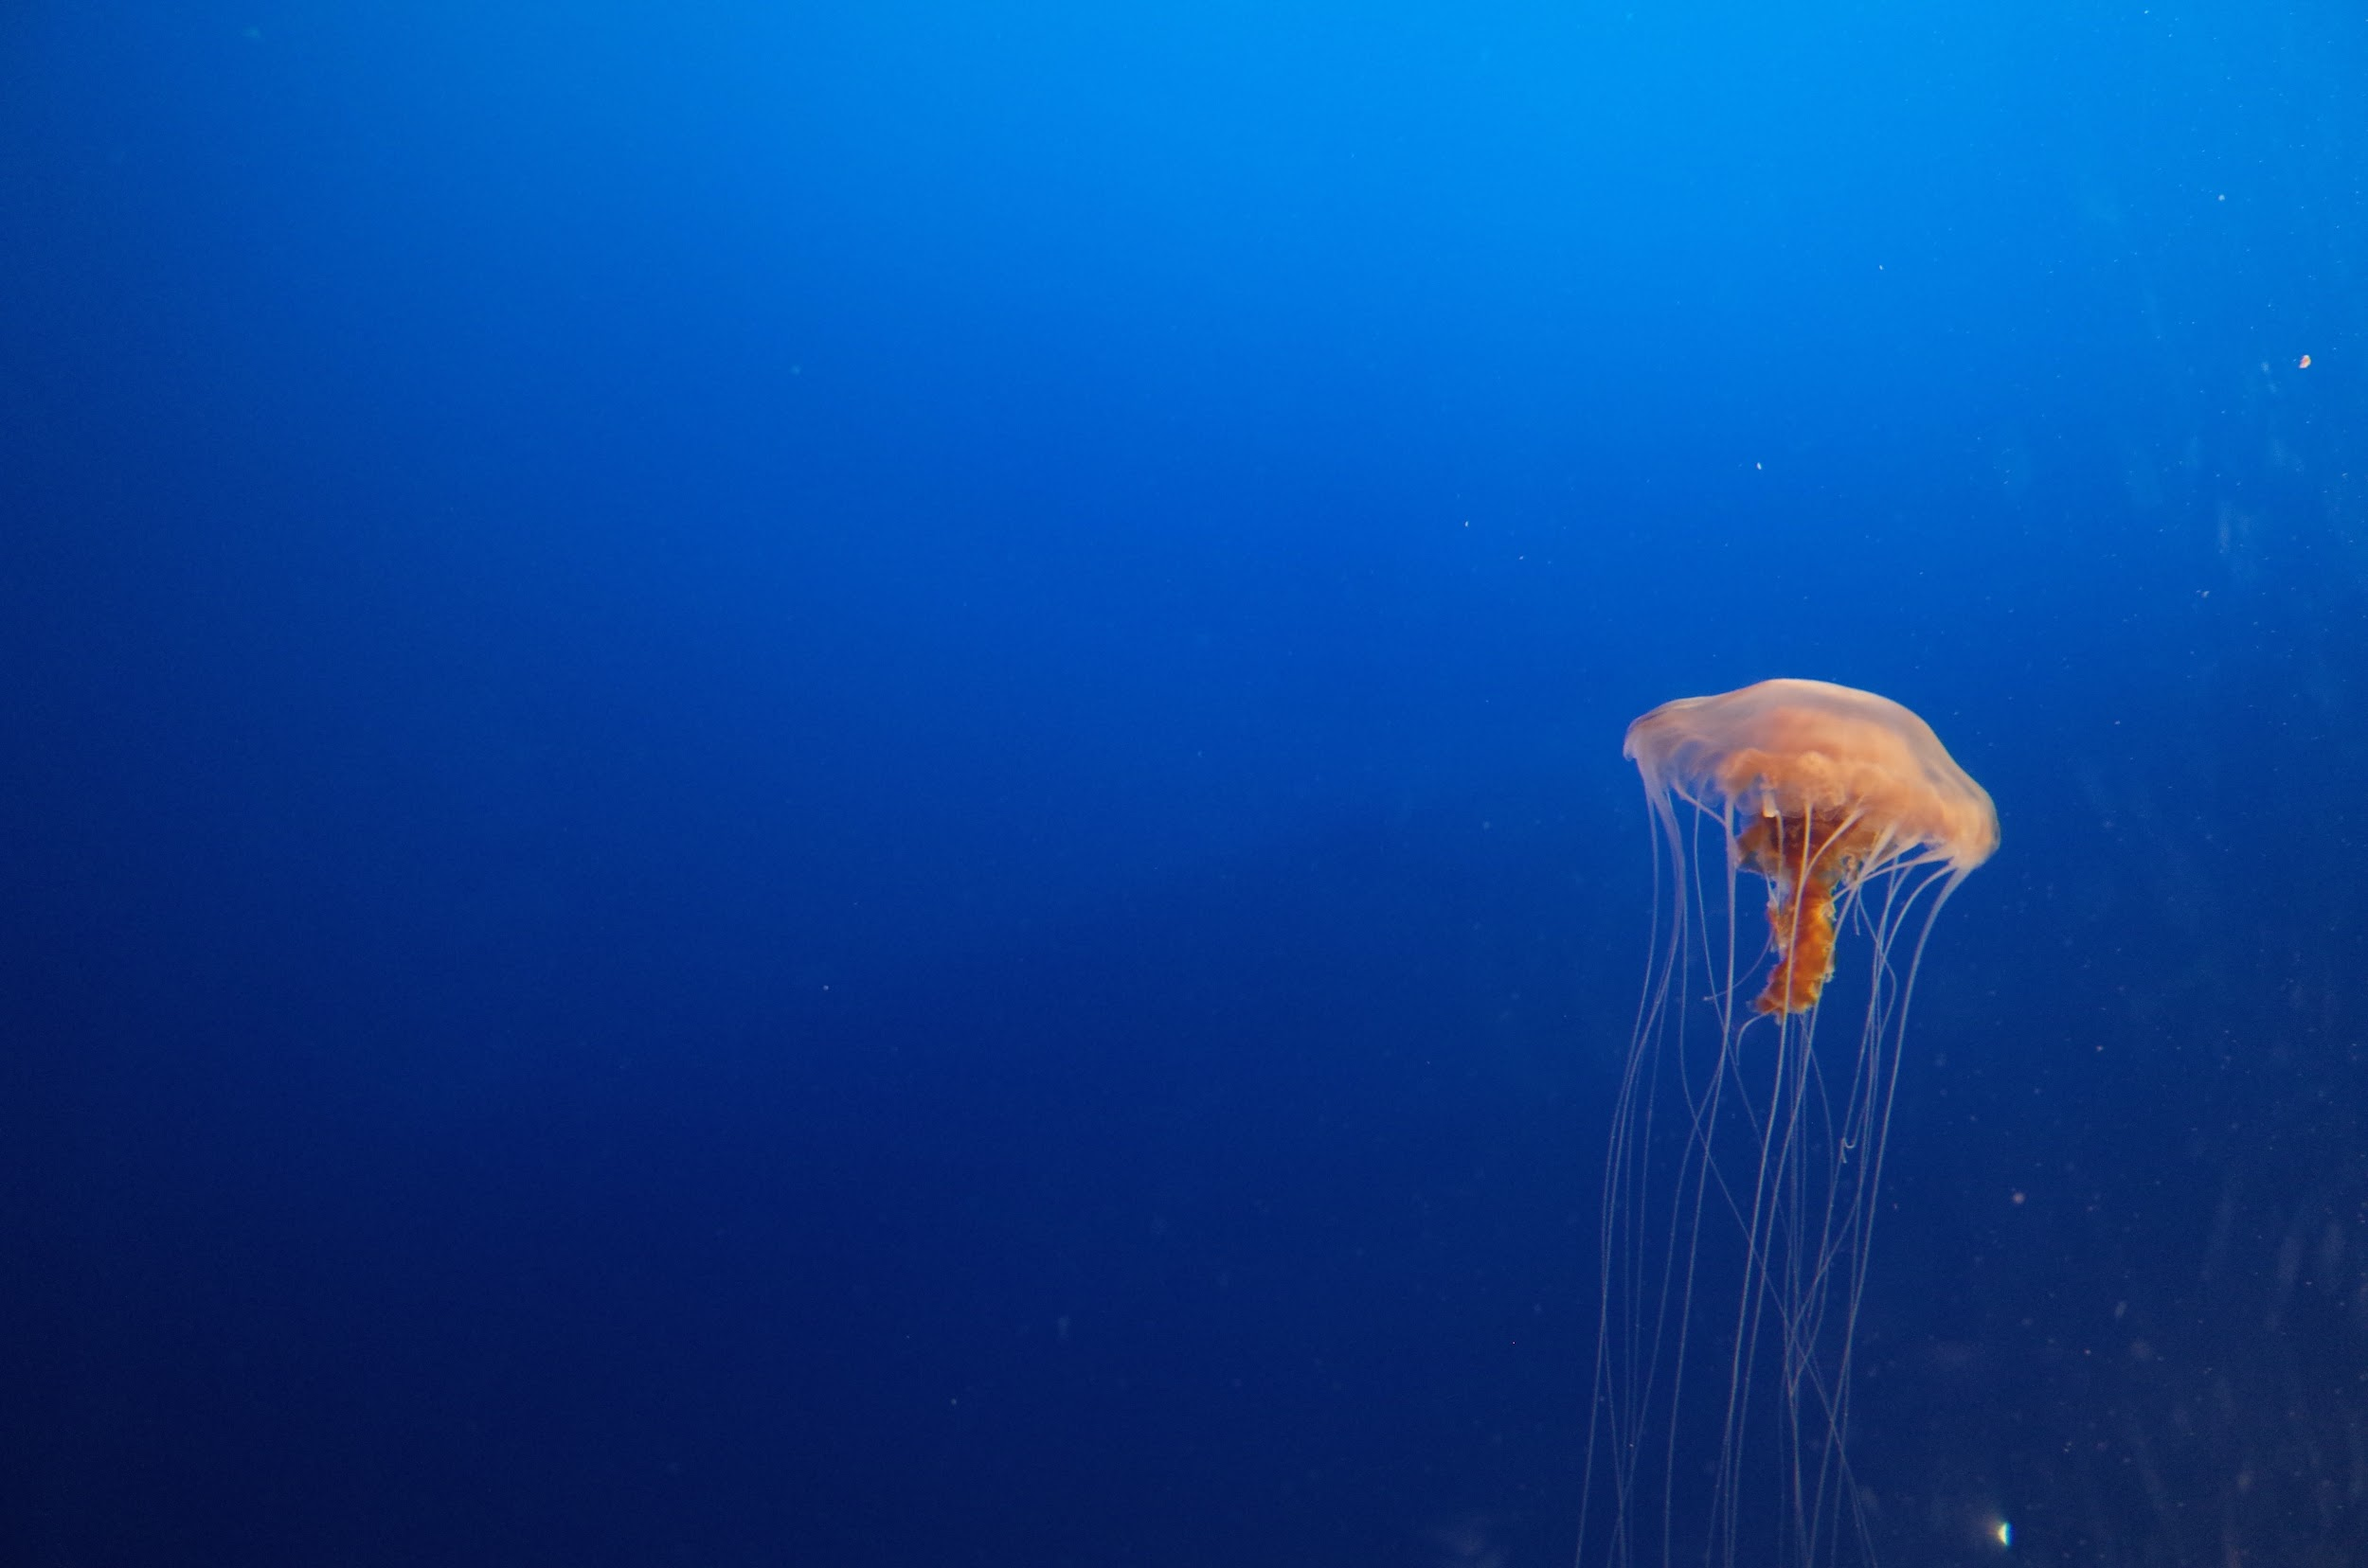

Deep Speech Architecture: Overview
SoftMax
Softmax Layer
Feedforward Layer
Recurrent Layer
Feedforward Layers
Input Features

Slide 14
Deep Speech Architecture: Input Features
SoftMax
Mel-Frequency Cepstrum Coefficients
• 16 bit audio input at 16kHz
• 32ms audio window every 20ms
• 26 Cepstral Coefficients
• Context window width 9

Slide 15
Deep Speech Architecture: Feedforward Layers
SoftMax
Feedforward Layers
• 3 layers
• Layer width 2048
• RELU cells
• RELU clipped at 20
• Dropout 0.20 to 0.30

Slide 16
Deep Speech Architecture: Bidirectional RNN Layer
SoftMax
Recurrent Layer
• 1 layer
• Layer width 2048
• LSTM cells
• No clipping
• Dropout 0.20 to 0.30

Slide 17
Deep Speech Architecture: Feedforward Layer
SoftMax
Feedforward Layer
• 1 layer
• Layer width 2048
• RELU cells
• RELU clipped at 20
• Dropout 0.20 to 0.30

Slide 18
Deep Speech Architecture: Softmax Layer
SoftMax
Softmax Layer
• L ≡ Alphabet
• Output width k ≡ |L| + 1
• Extra for a “blank label”

Slide 19
3.2 CTC Algorithm

Slide 20
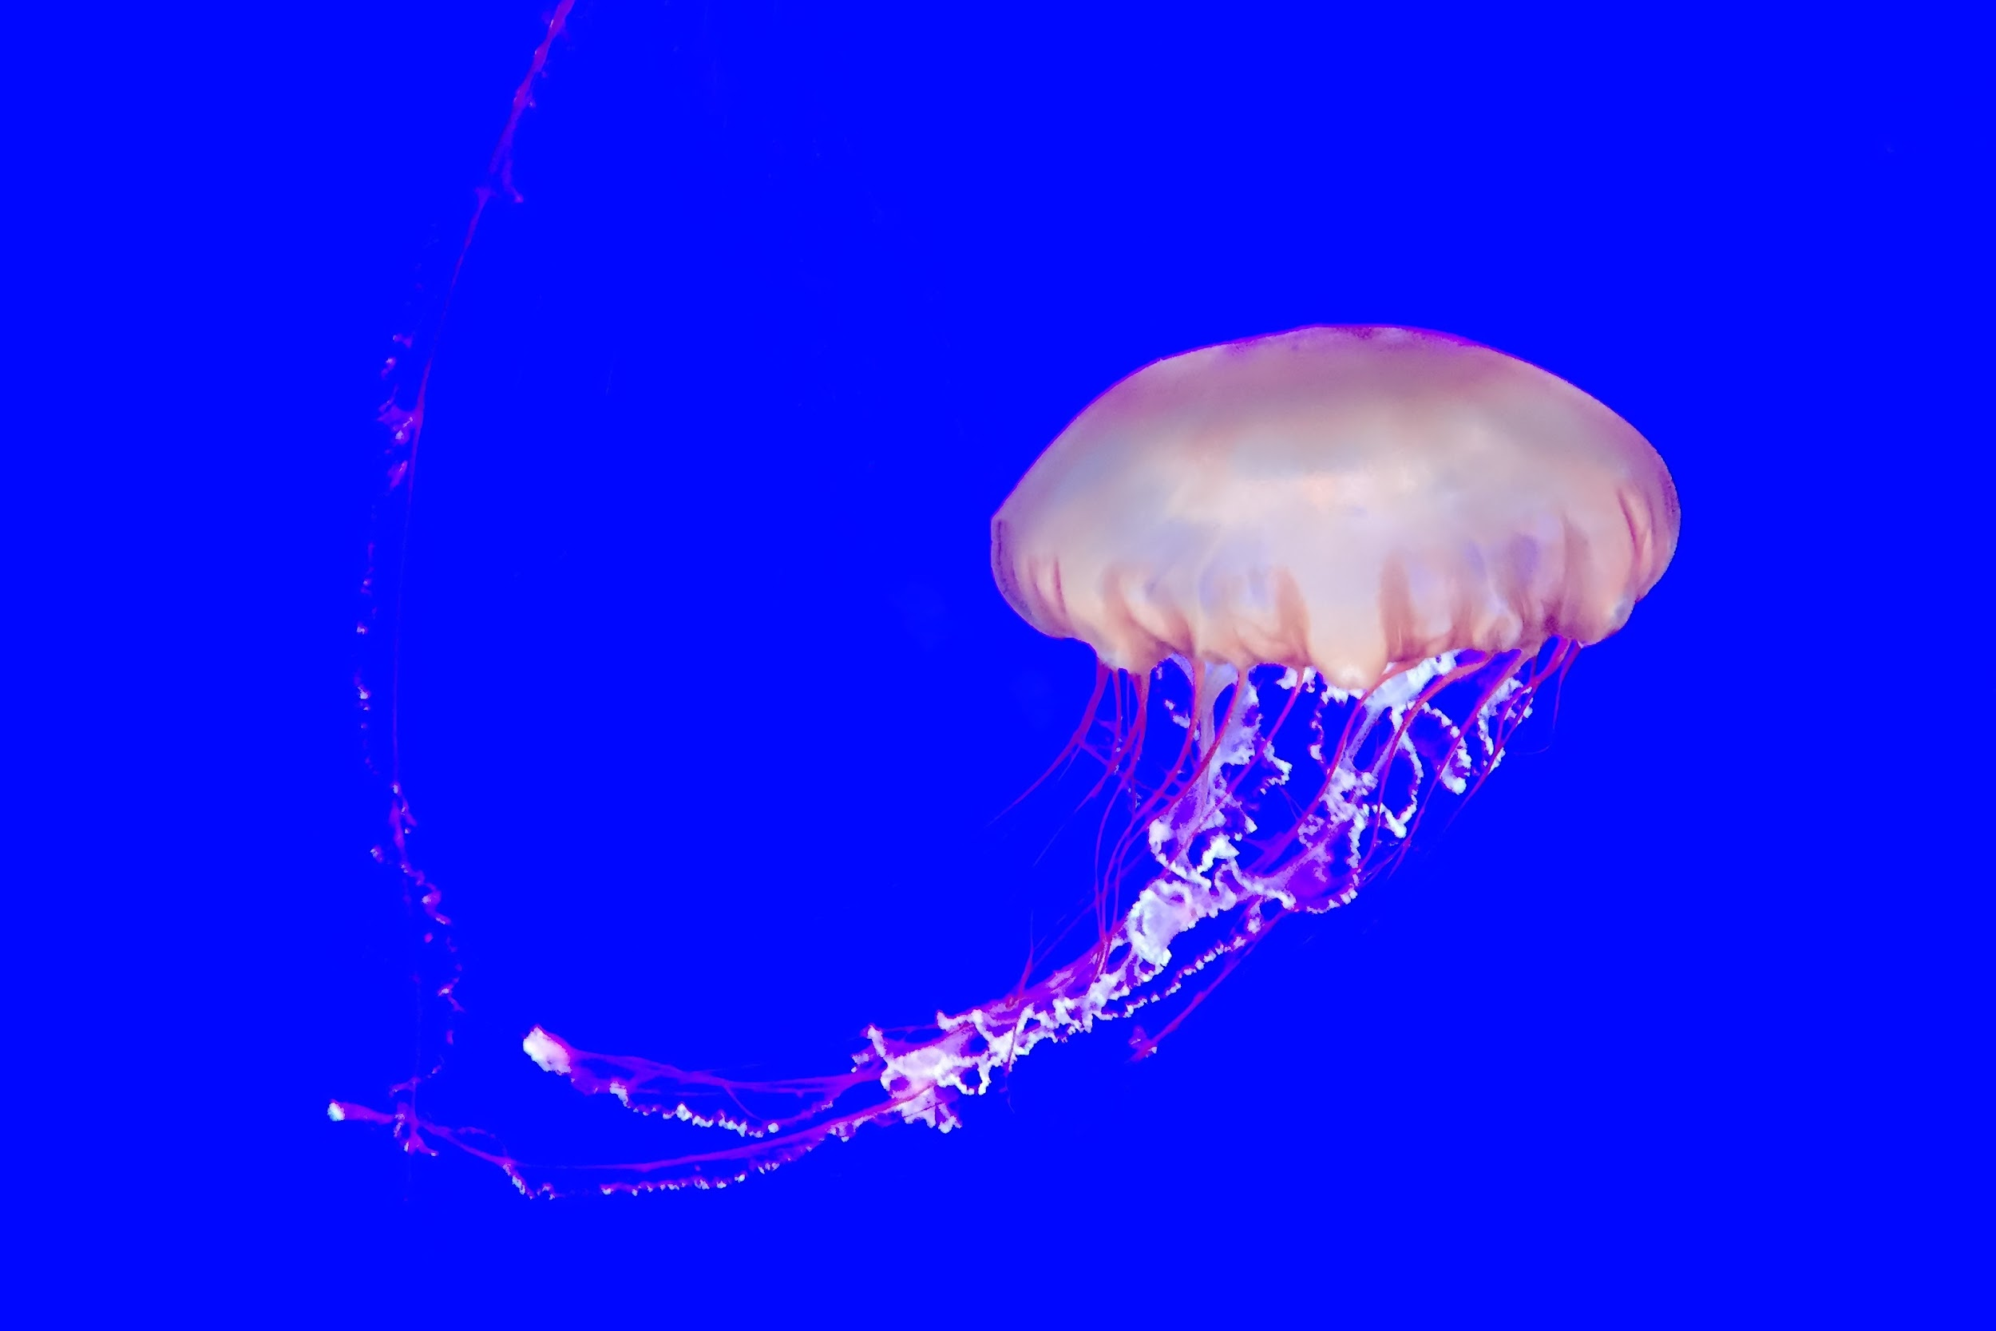
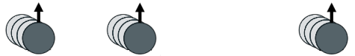
CTC Algorithm: Path Probabilities
1-of-k
1-of-k
1-of-k
SoftMax
• L ≡ Alphabet
• k ≡ |L| + 1
• Extra “blank label”

Slide 21
CTC Algorithm: Path Probabilities
1-of-k
1-of-k
1-of-k
T ≡ Time Ticks
SoftMax
Path ≡ Seq of T characters
L’ ≡ L ∪ {blank}
π ∈ L’^{T}

Slide 22
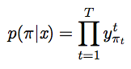
CTC Algorithm: Path Probabilities
y_{π}¹
y_{π}²
y_{π}^{T}
1
2
T
SoftMax
Path Probability

Slide 23
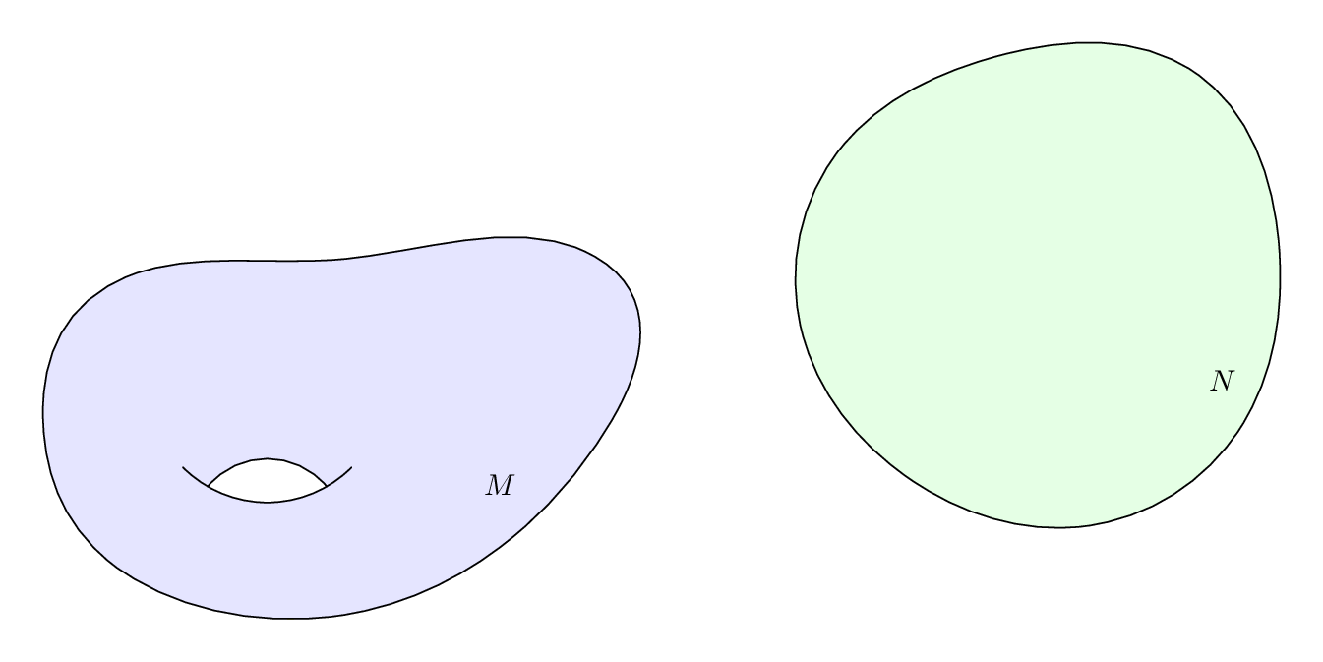
CTC Algorithm: Label Probabilities
L’^{T}
L^{≤T}
Def: ℬ
• Remove repeated characters
• Remove blanks
ℬ
Labels
Paths

Slide 24
CTC Algorithm: Label Probabilities
L’^{T}
L^{≤T}
Def: ℬ
• Remove repeated characters
• Remove blanks
ℬ
Labels
Paths

Slide 25
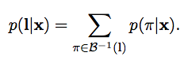
CTC Algorithm: Label Probabilities
y_{π}¹
y_{π}²
y_{π}^{T}
1
2
T
SoftMax
Label Probability

Slide 26
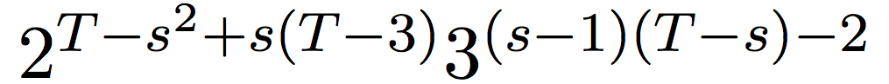
CTC Algorithm: Label Probabilities
y_{π}¹
y_{π}²
y_{π}^{T}
1
2
T
SoftMax
Label Probability
Problem Sum is Big

Slide 27
CTC Algorithm: Label Probabilities
y_{π}¹
y_{π}²
y_{π}^{T}
1
2
T
SoftMax
Label Probability
Solution
Forward-Backward
Algorithm

Slide 28
3.3 Language Model

Slide 29
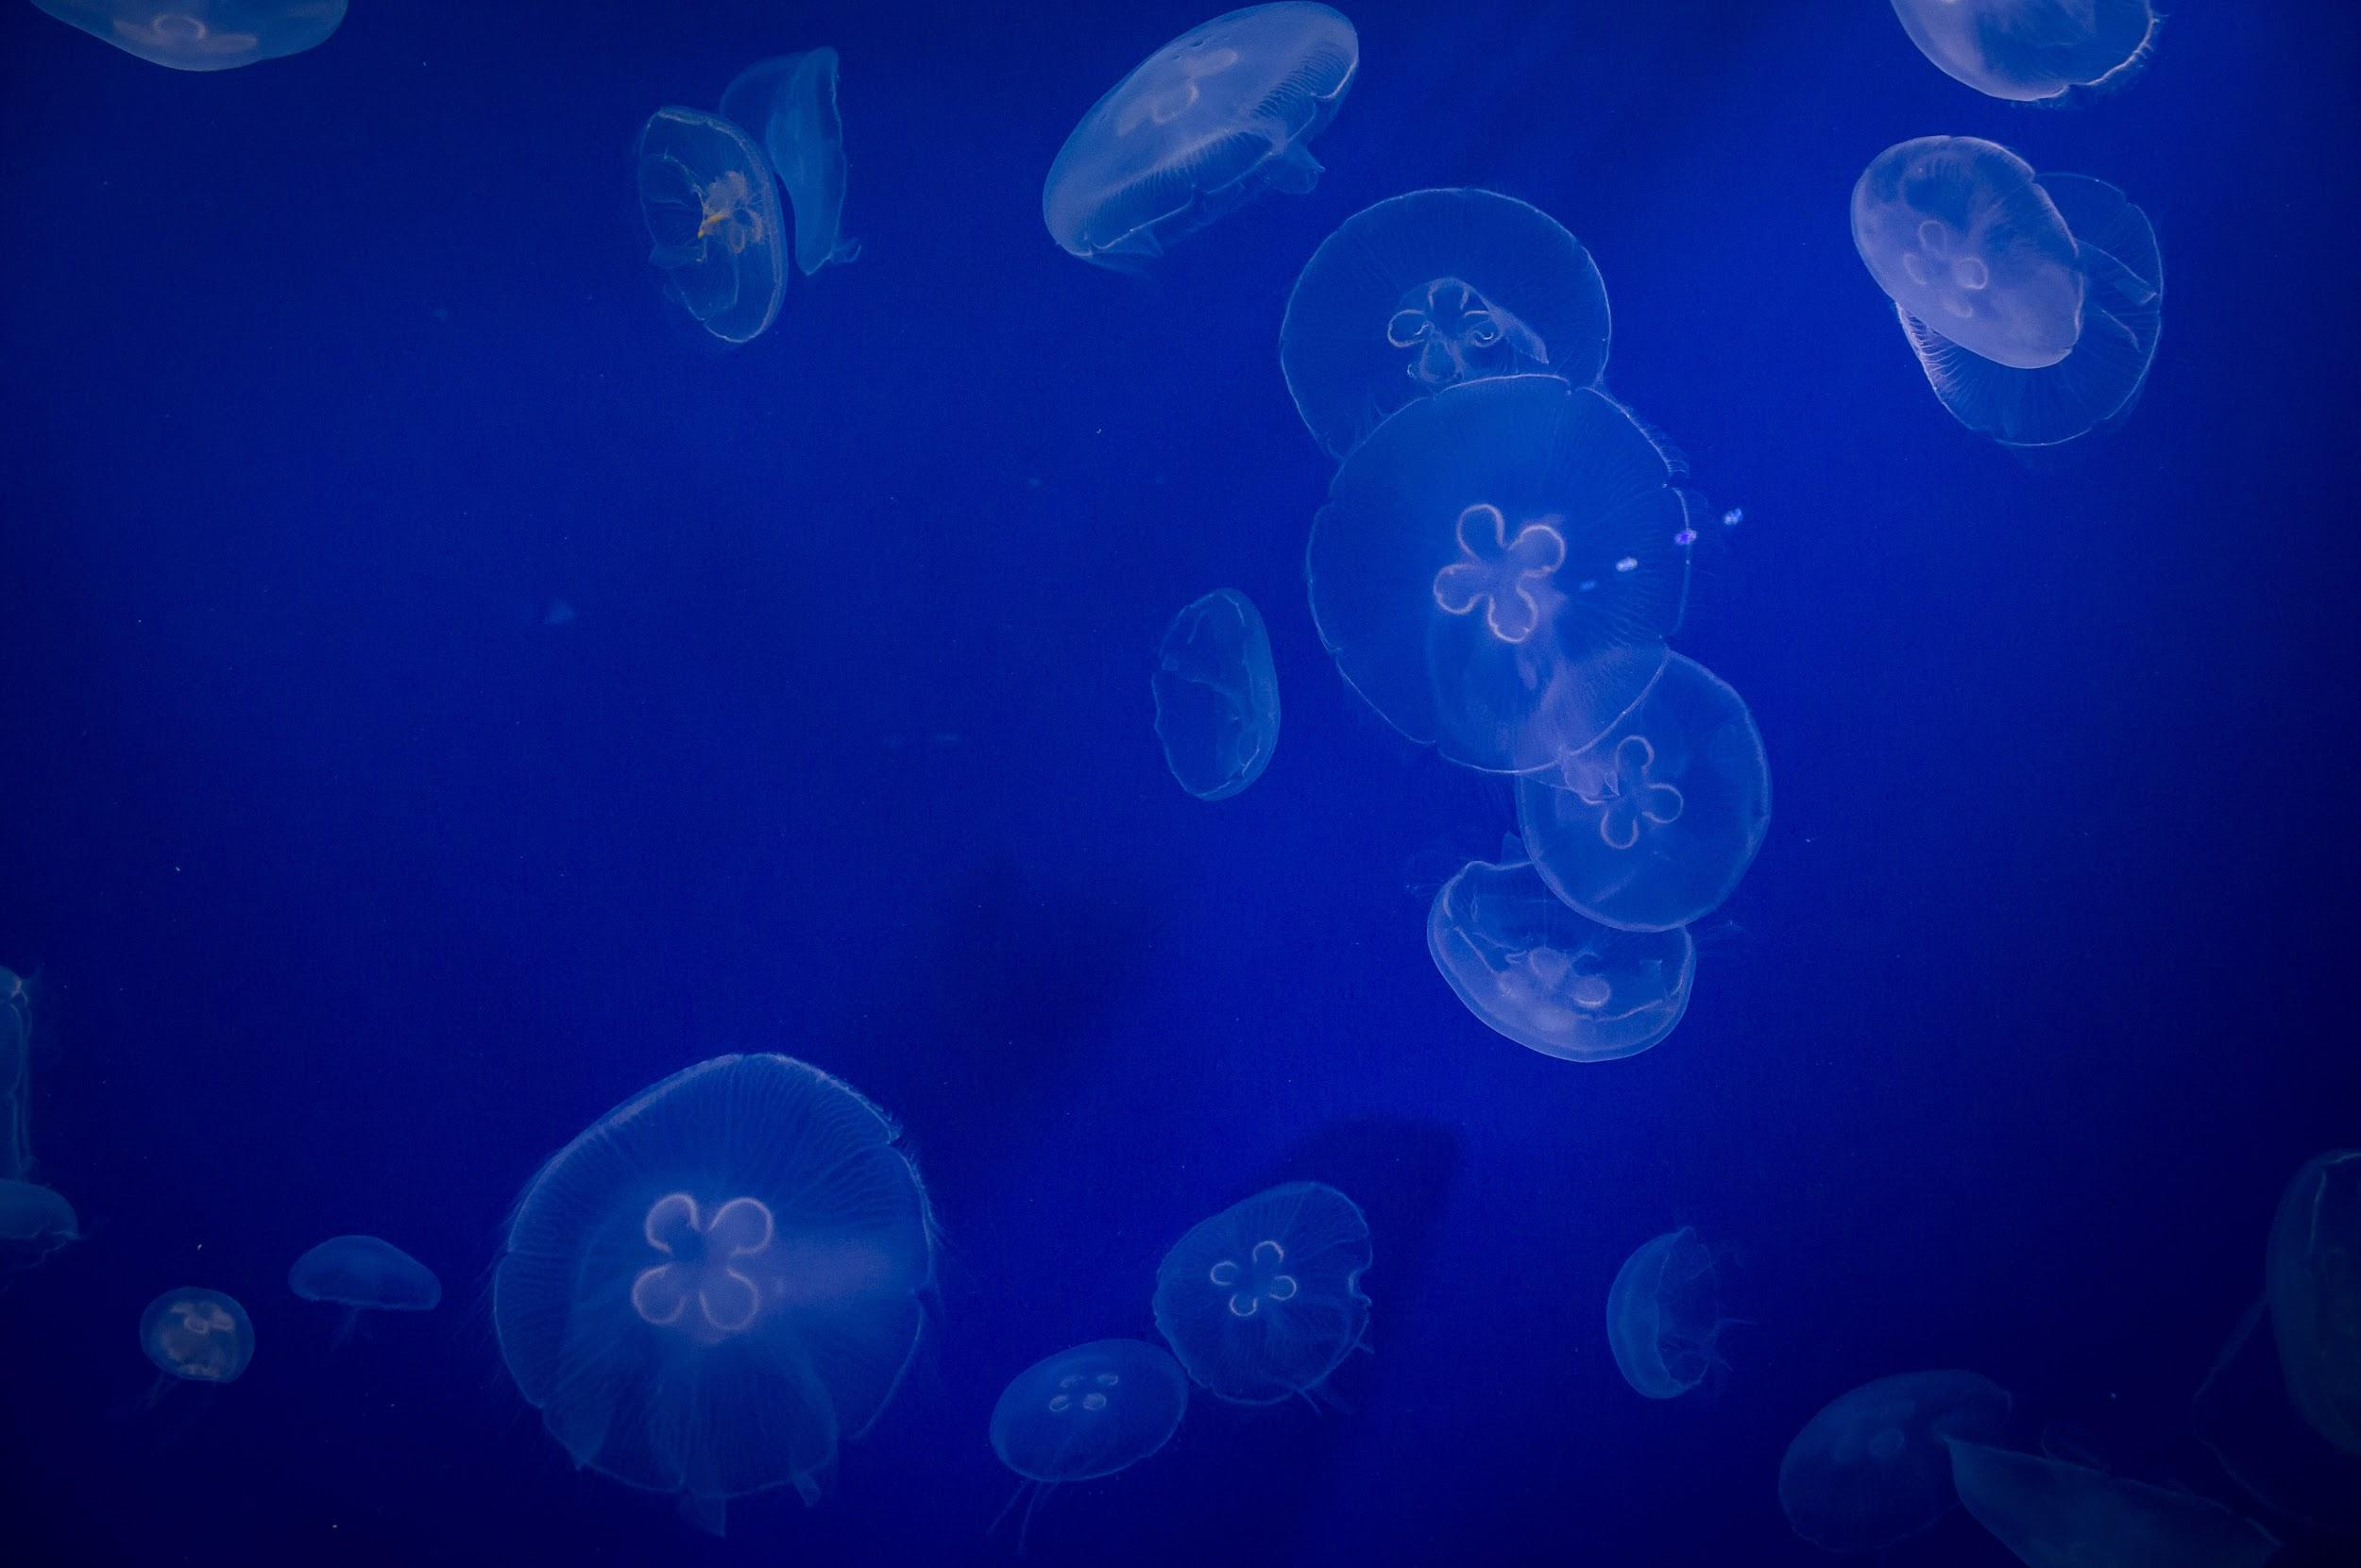
Language Model: Definition
Sequences of characters
p_{LM}( l₃ )
p_{LM}( l₂ )
Def: Language Model
p_{LM}( l₄ )
p_{LM}( l₁ )
Language Model-”Probability distribution” over sequences of characters
l₄
l₁
l₂
Labels
l₃

Slide 30
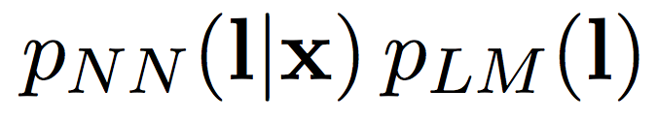
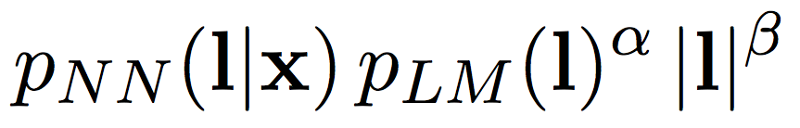
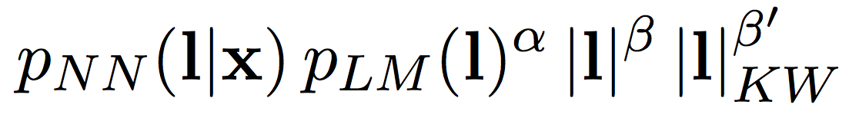
Language Model: Loss Function
Loss Function Version 1.0
y_{π}¹
y_{π}²
y_{π}^{T}
1
2
T
SoftMax
Loss Function Version 2.0
Loss Function Version 3.0
Loss Function Version 4.0

Slide 31
Language Model: Loss Function
y_{π}¹
y_{π}²
y_{π}^{T}
1
2
T
Loss Function Version 4.0
SoftMax
α = 0.75
β = 1.85

Slide 32
3.4 Performance

Slide 33

Performance: WER
Training Data
• Fisher (2000 hours)
• Switchboard (240 hours)
• Librivox (1000 hours)
• Common Voice (600 hours)

Slide 34
Performance: WER
Training Data
• Fisher (2000 hours)
• Switchboard (240 hours)
• Librivox (1000 hours)
• Common Voice (600 hours)
On Librivox clean test 8.26% WER

Slide 35
Performance: WER
Human
5.8% WER
Training Data
• Fisher (2000 hours)
• Switchboard (240 hours)
• Librivox (1000 hours)
• Common Voice (600 hours)
On Librivox clean test 8.26% WER
Google
12.1% WER
¹Dernoncourt et. al, A Framework for Speech Recognition Benchmarking

Slide 36
4 Future of Deep Speech

Slide 37
4.1 UTF-8

Slide 38
UTF-8: Softmax Layer
SoftMax
Softmax Layer
• L ≡ 256
• Output width k ≡ |L| + 1
• Extra for a “blank label”

Slide 39
4.2 Non-English Languages

Slide 40

Non-English Languages: Common Voice

Slide 41
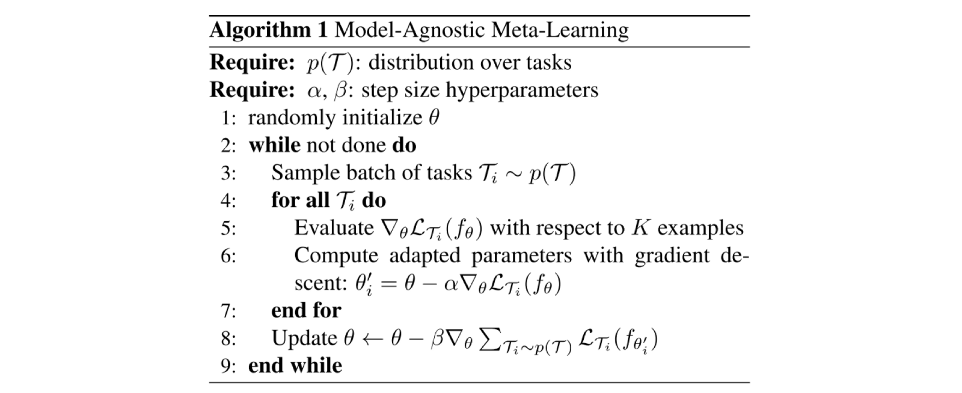
Non-English Languages: MAML

Slide 42
4.3 Small Platform Devices

Slide 43
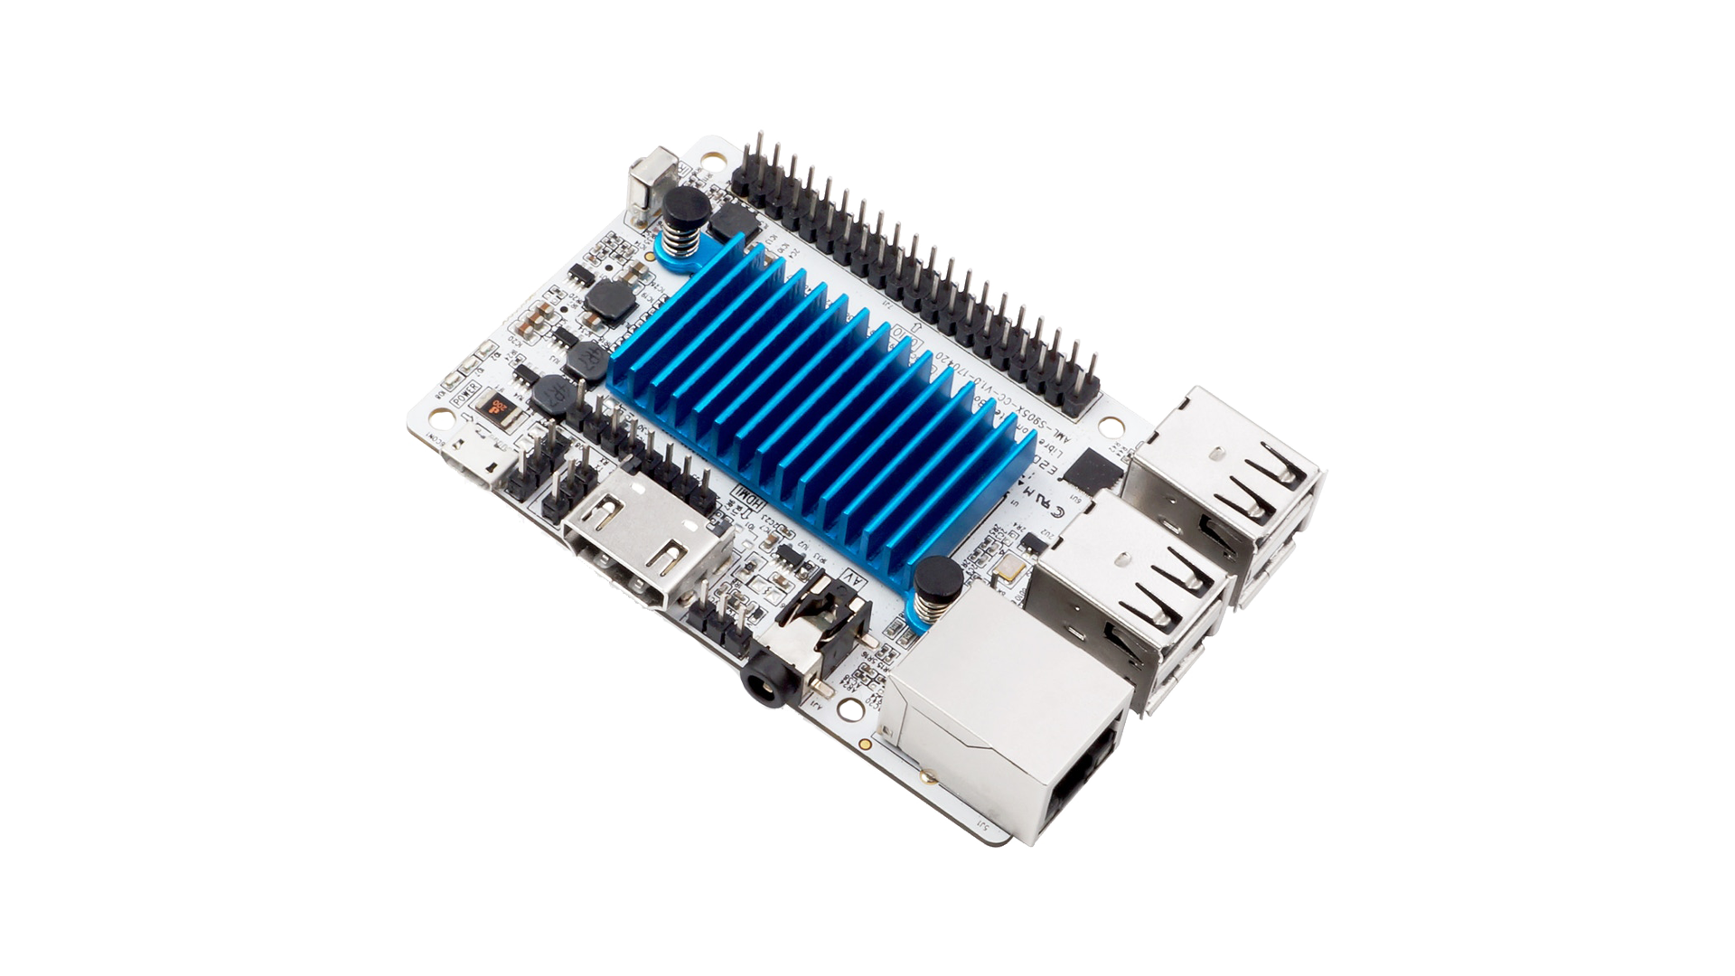
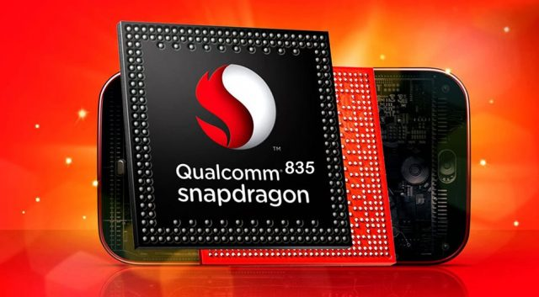
Small Platform Devices
Snapdragon 835
Le Potato

Slide 44
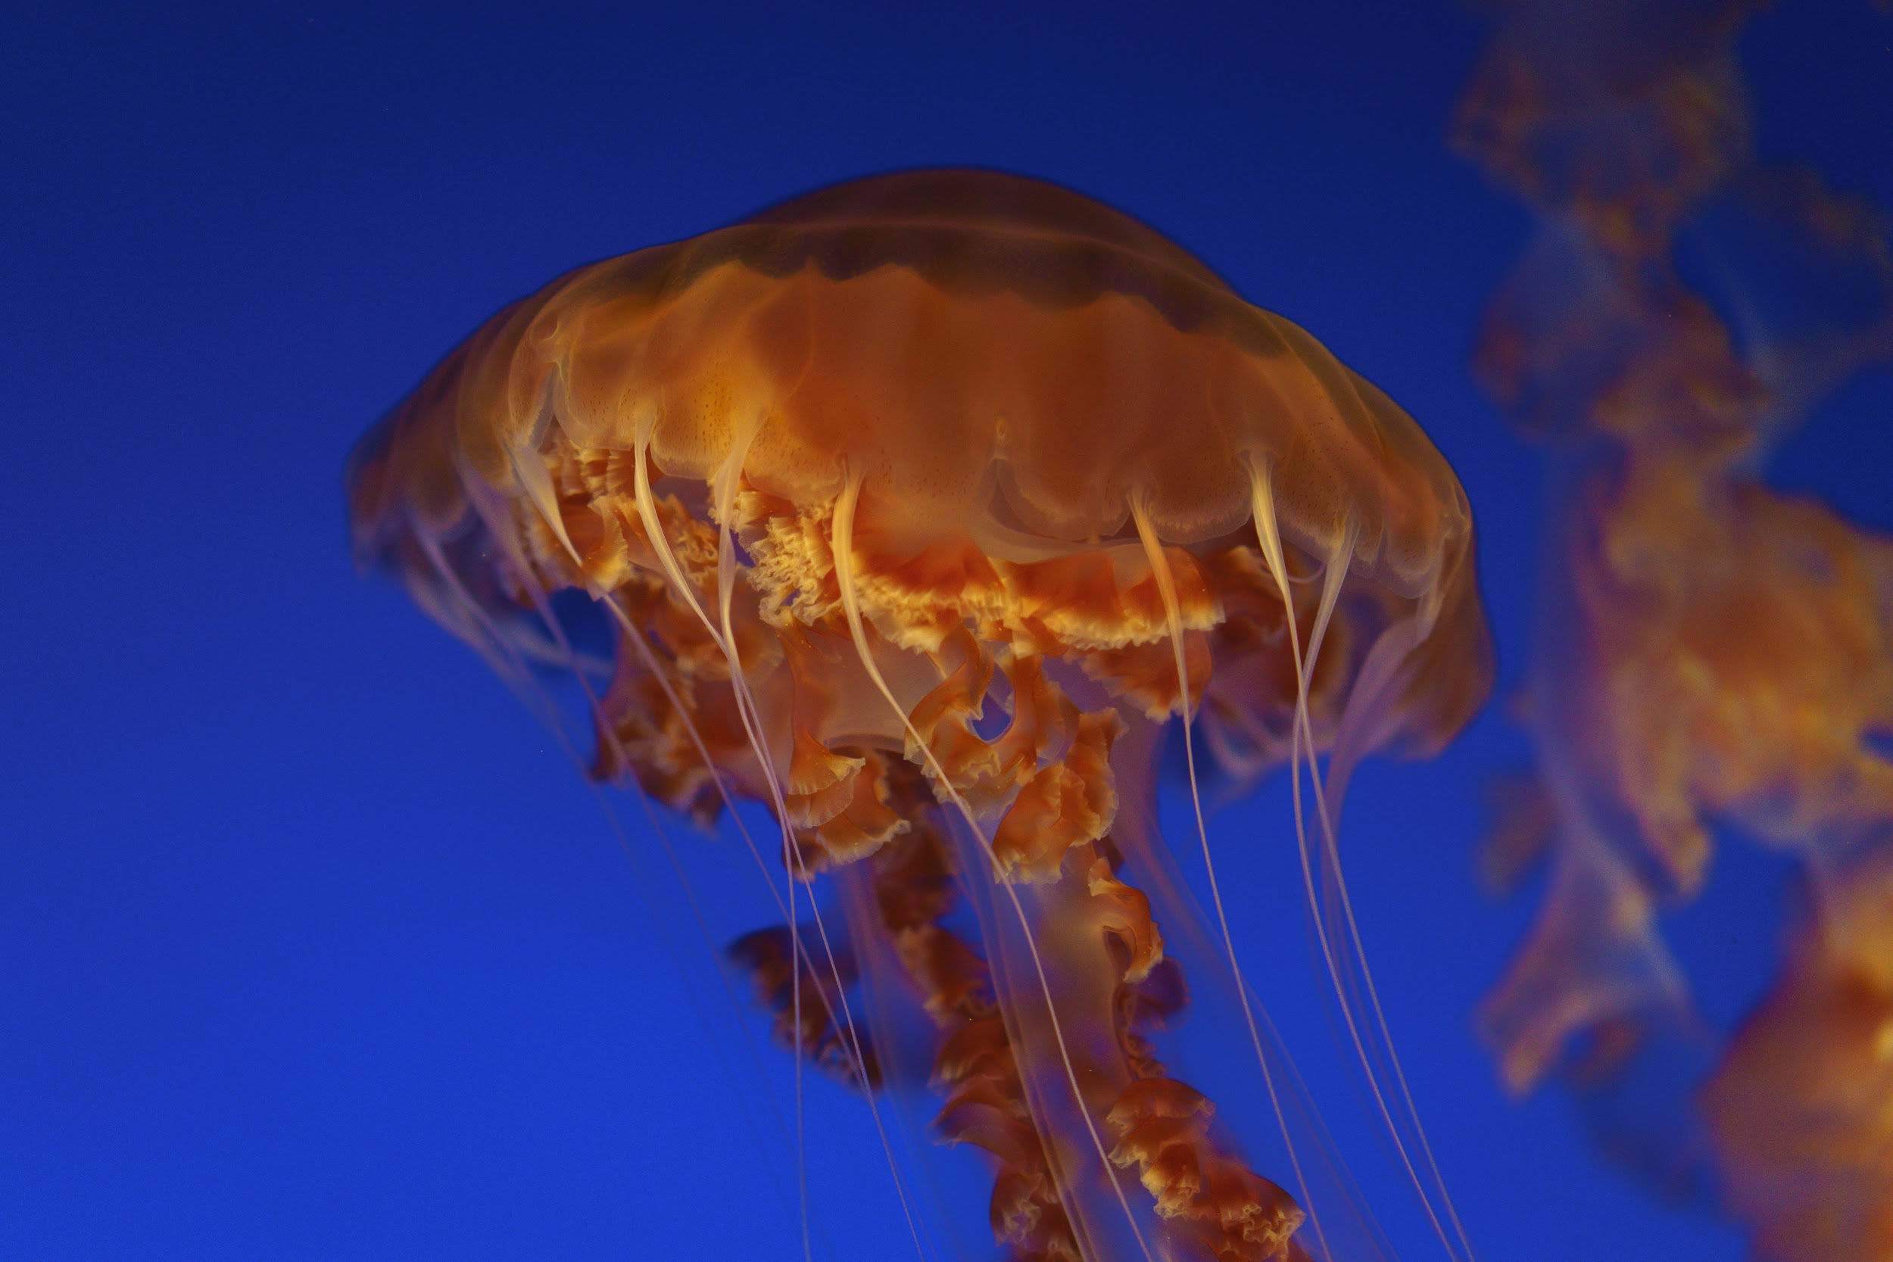
Murakoze...

